Slide 1
Teaching and Learning via Undergraduate Research:
Notes from the Harvard Forestry Data Science Lab
Grayson W. White¹, Kelly S. McConville²
¹ Michigan State University, ² Harvard University
Joint Statistical Meetings 2024
Portland, Oregon, USA
August 6, 2024

Slide 2
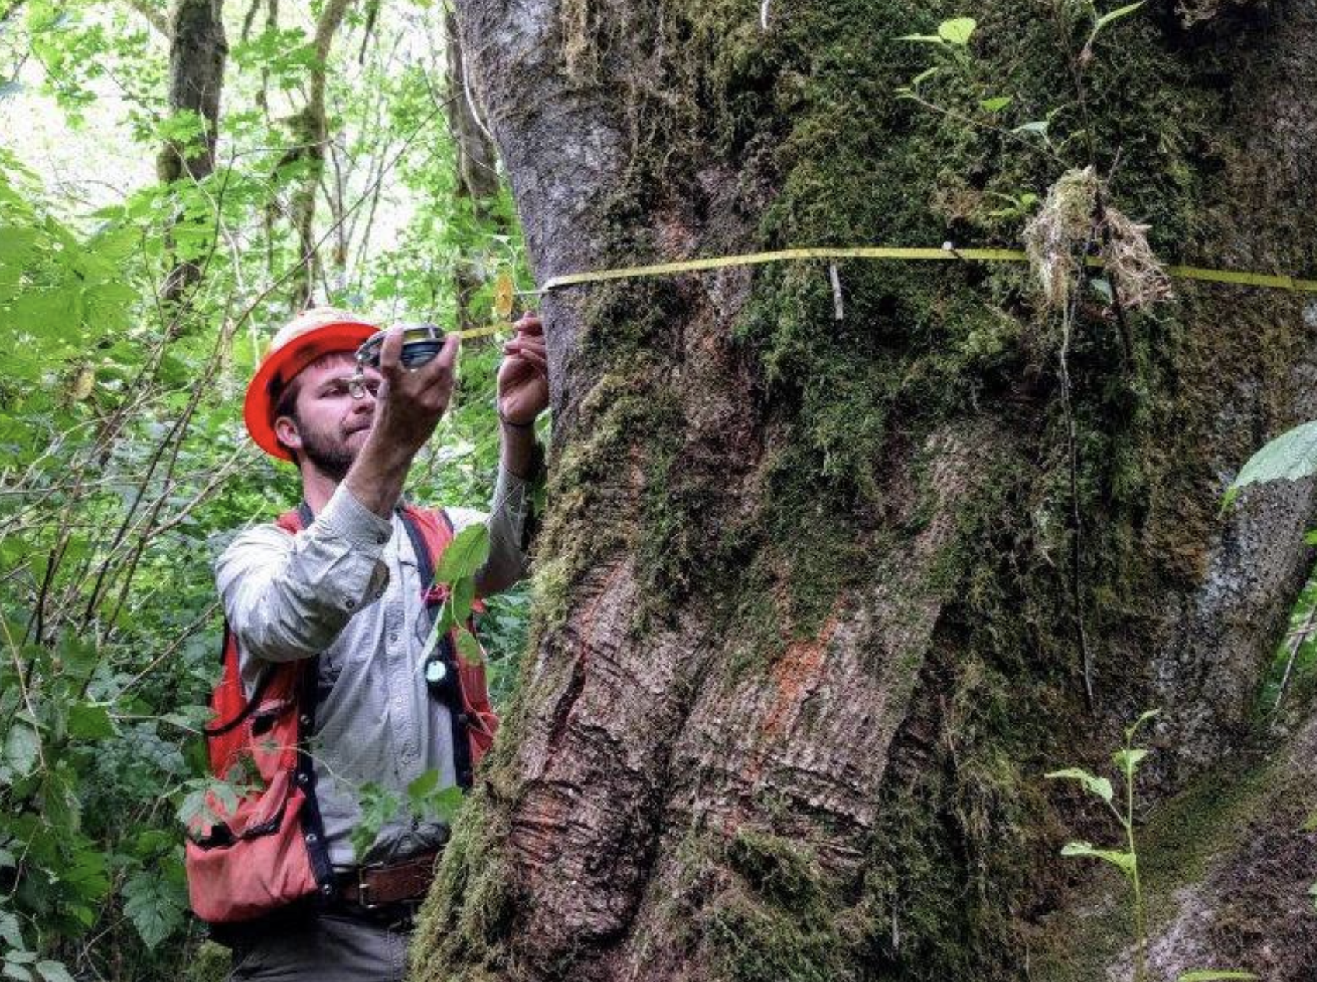
UFDS Program Overview
Ten-week summer program.
Answering genuine statistical questions from the US Forest Service and stakeholders.
Students from a variety of backgrounds and abilities.
Minimal “prerequisites”.

Slide 3
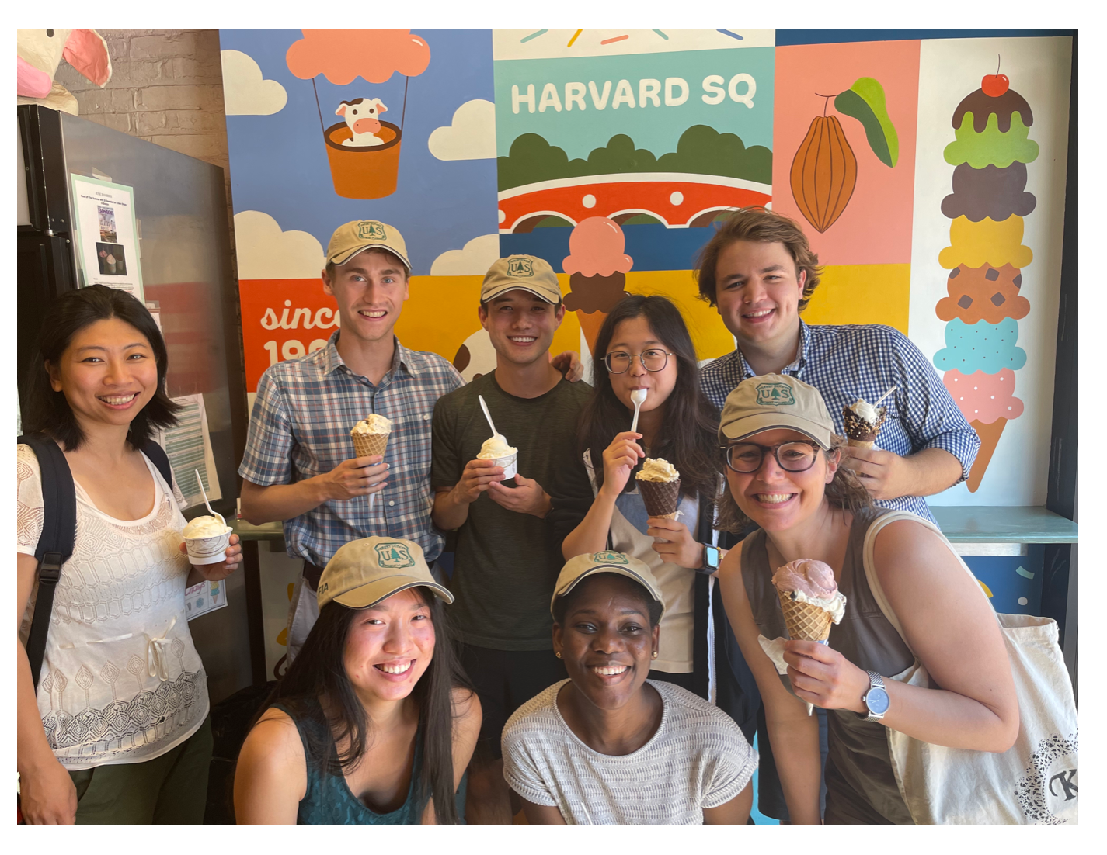
Student Experience
Most of the time, this is the student’s first research experience.
Curating research experience while being “productive”.
Sense of belonging: students present ideas, teaching peers in meetings etc.
Students as teachers: play off each other’s strengths.
Balance in workload and avoiding burnout: many fun group activities throughout the summer.

Slide 4
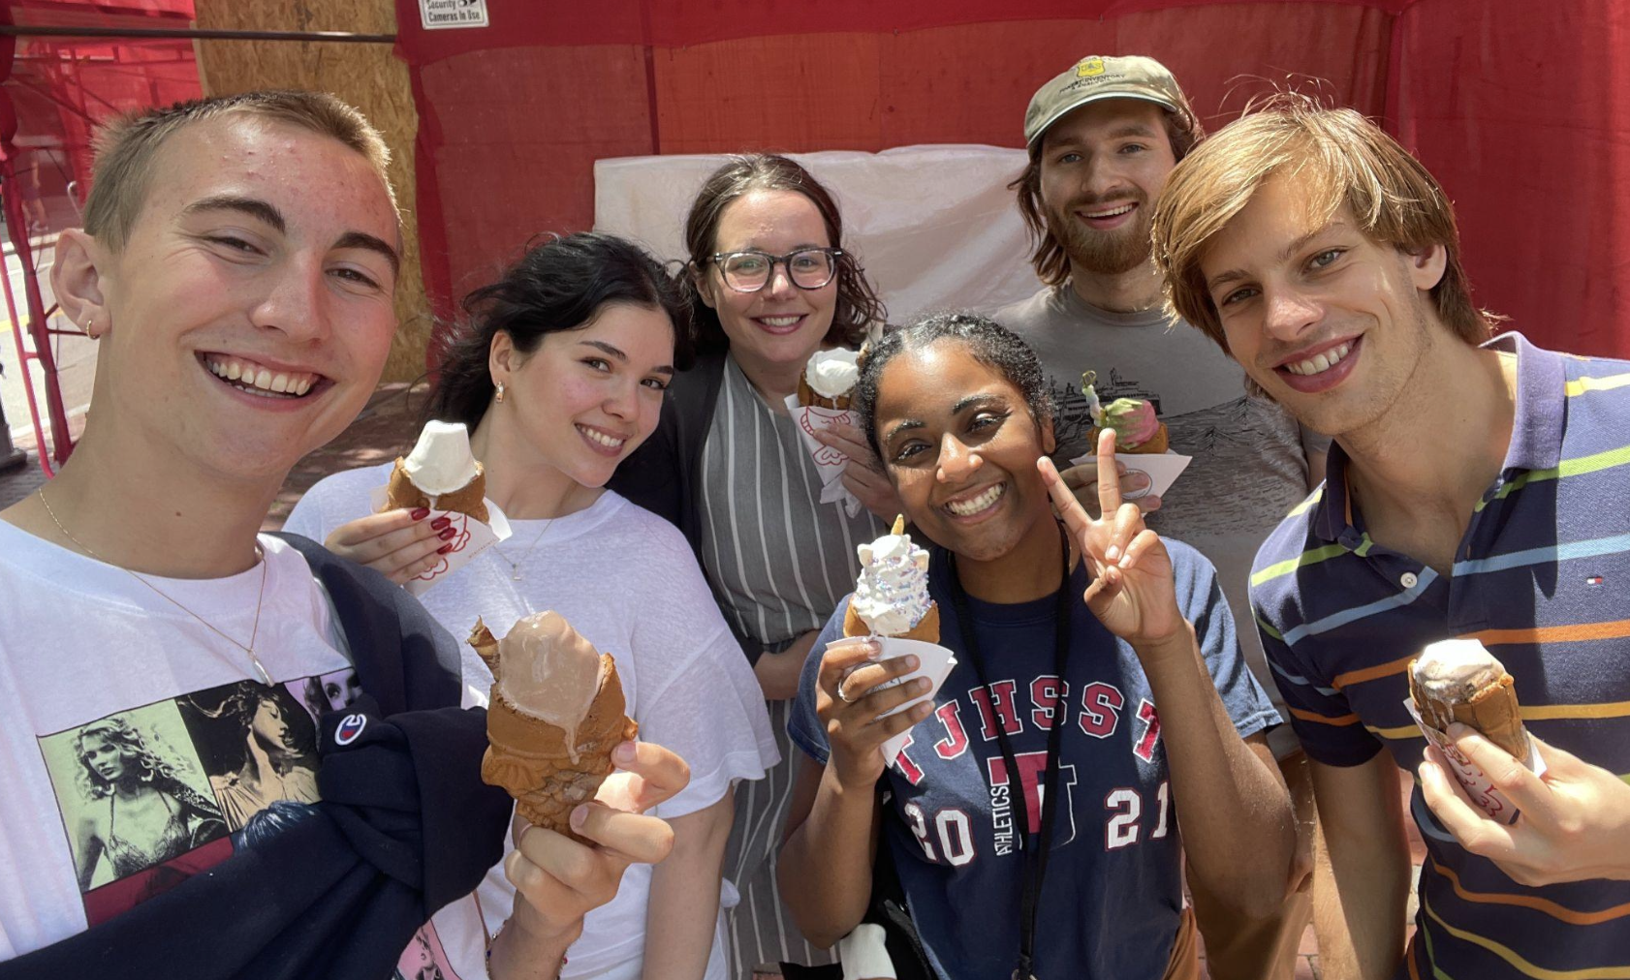
Outcomes
Confident students who want to further engage with research
Understanding the huge benefits of collaboration
Finding jobs that bring joy

Slide 5
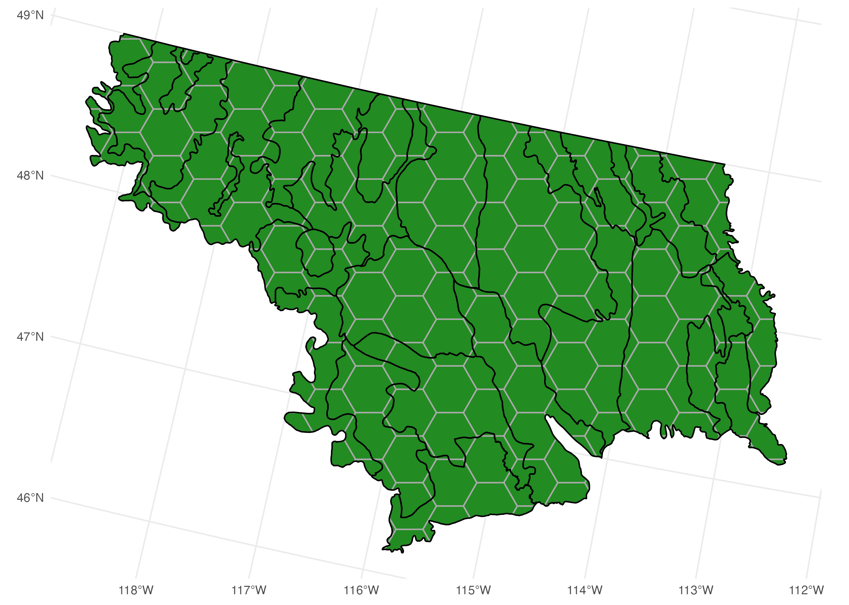
Project: Simulation Studies for Small Area Estimation
All four students from summer 2023, Dinan; Niels; Lal; and Thor, participated.
Each student worked on individual research questions or “dials” in the simulation study.

Slide 6
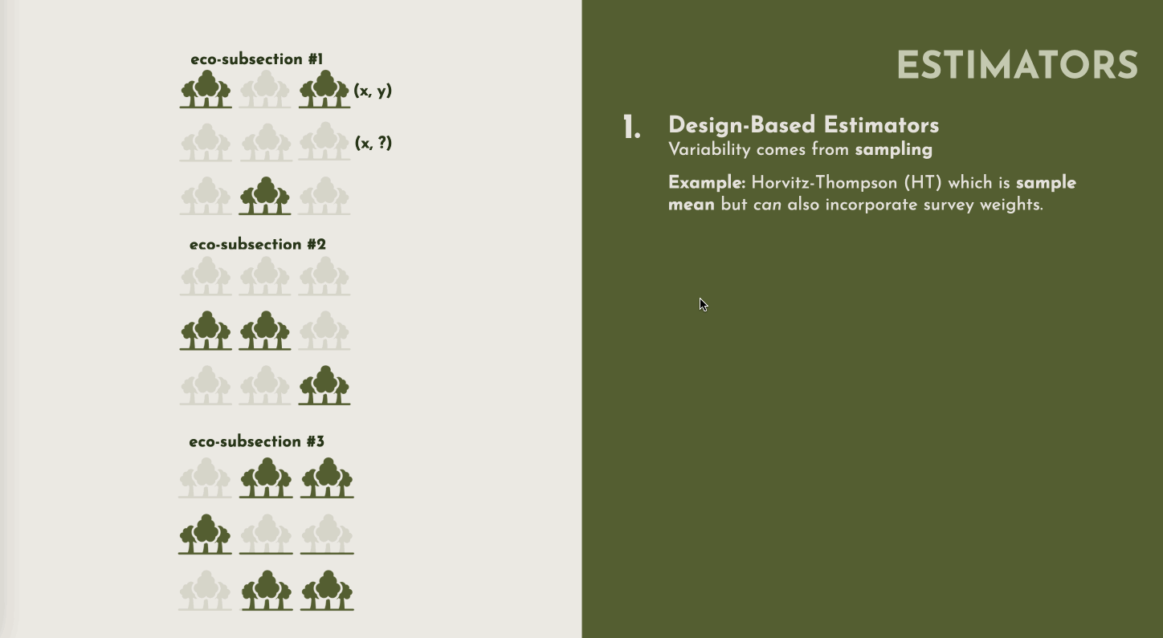

Slide 7
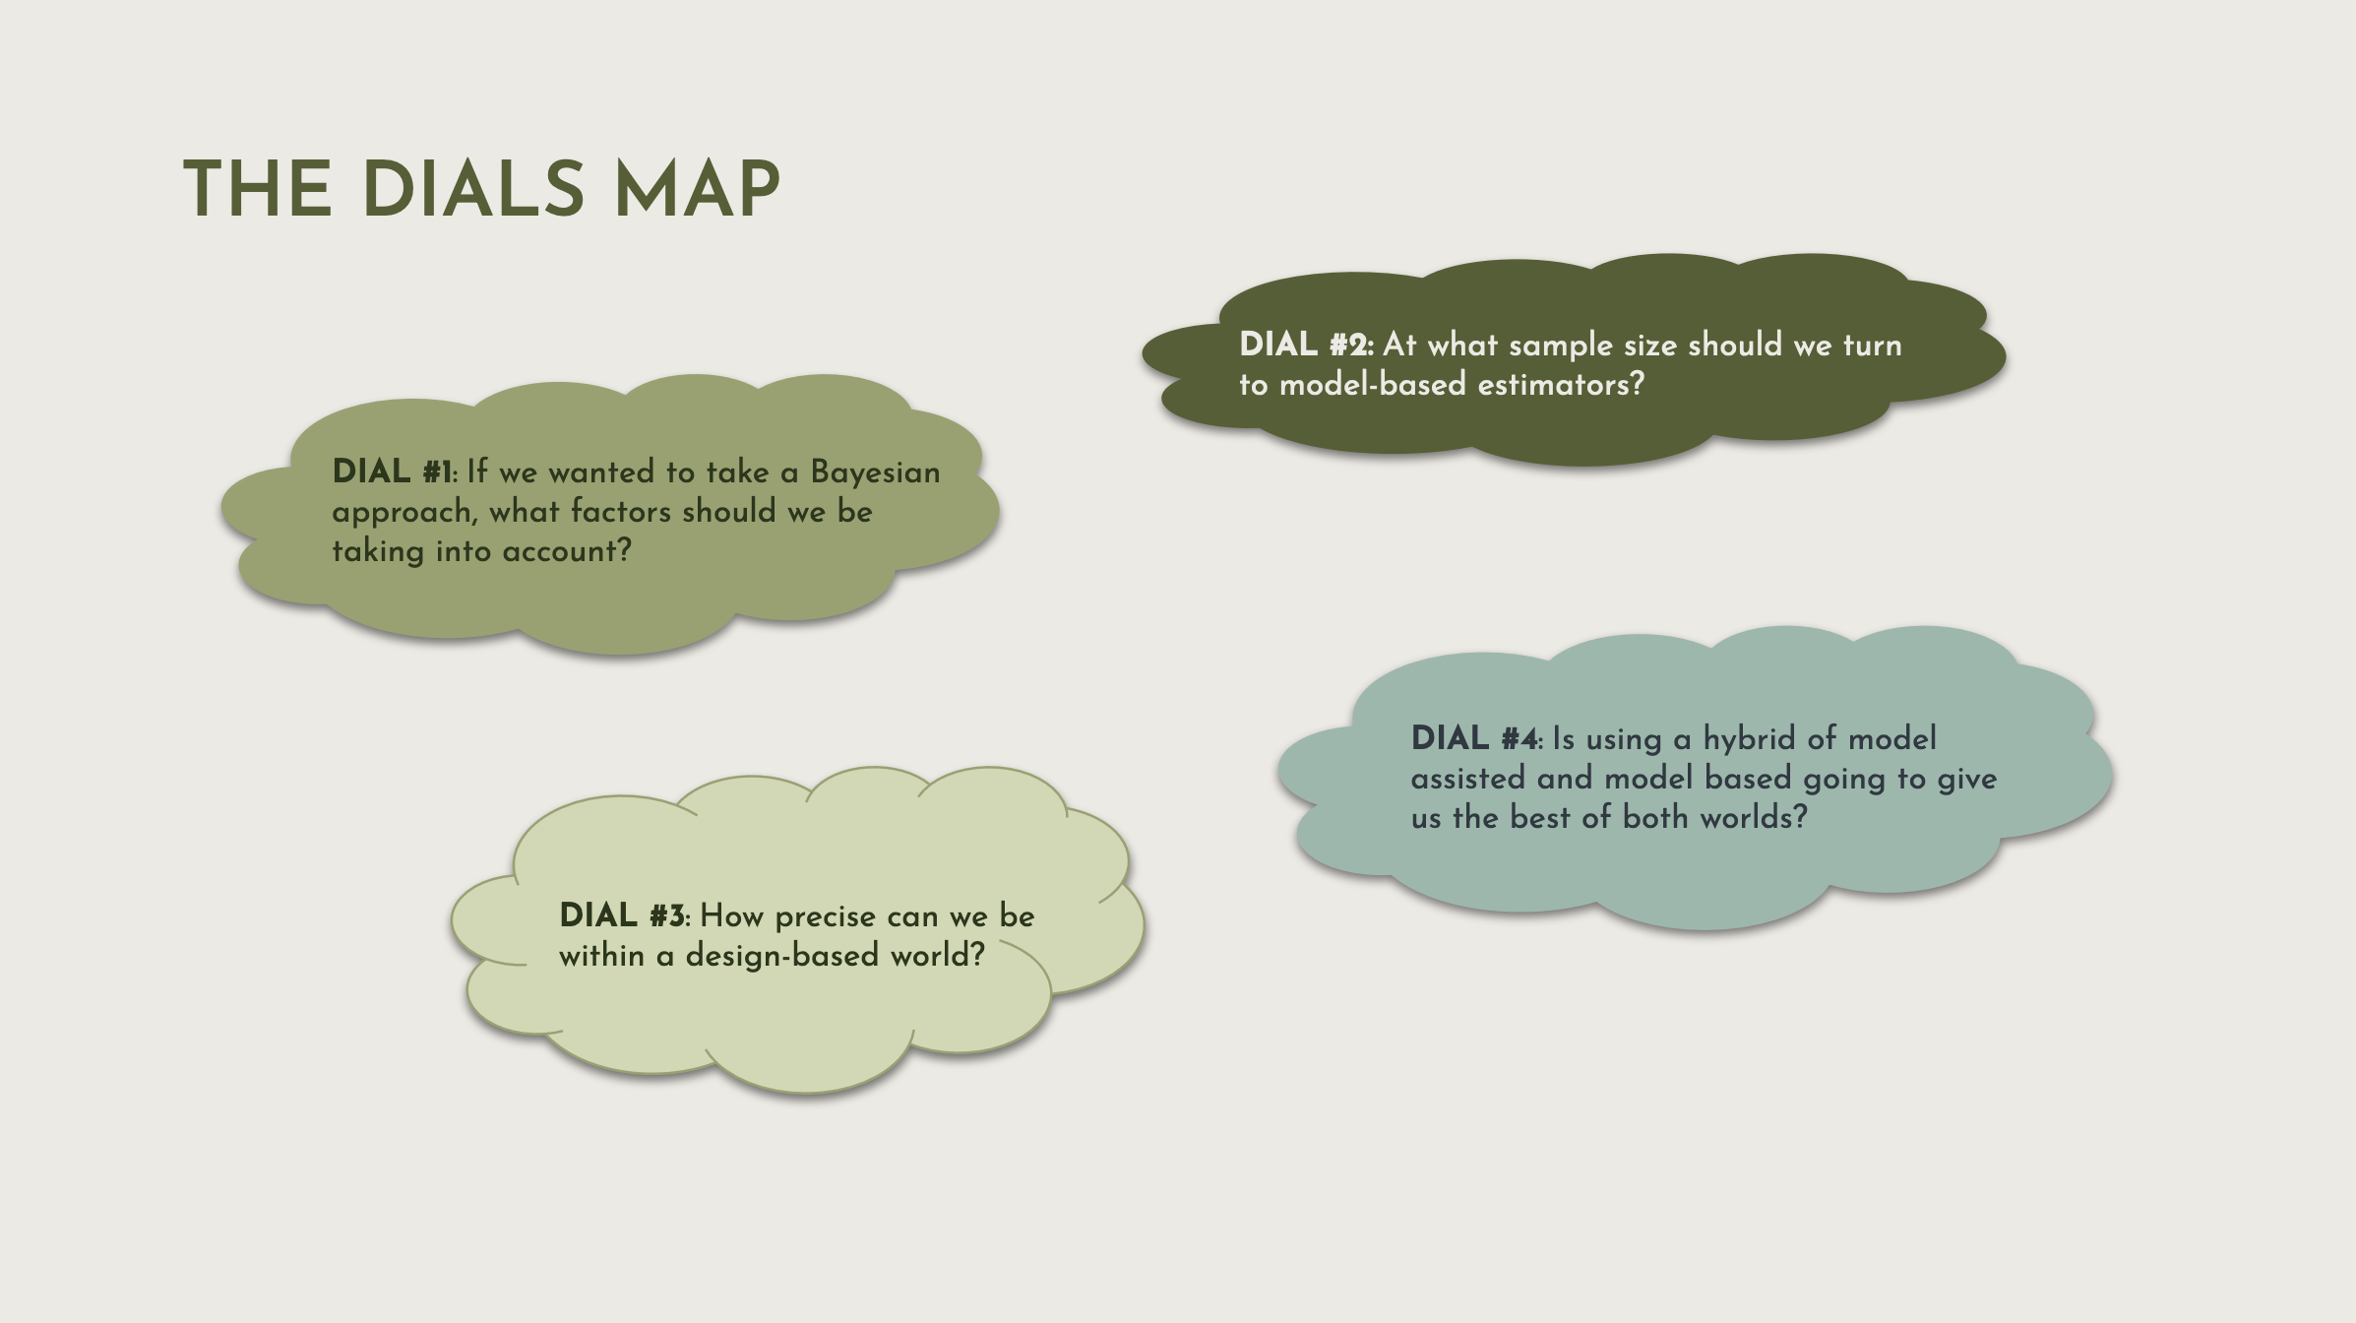

Slide 8
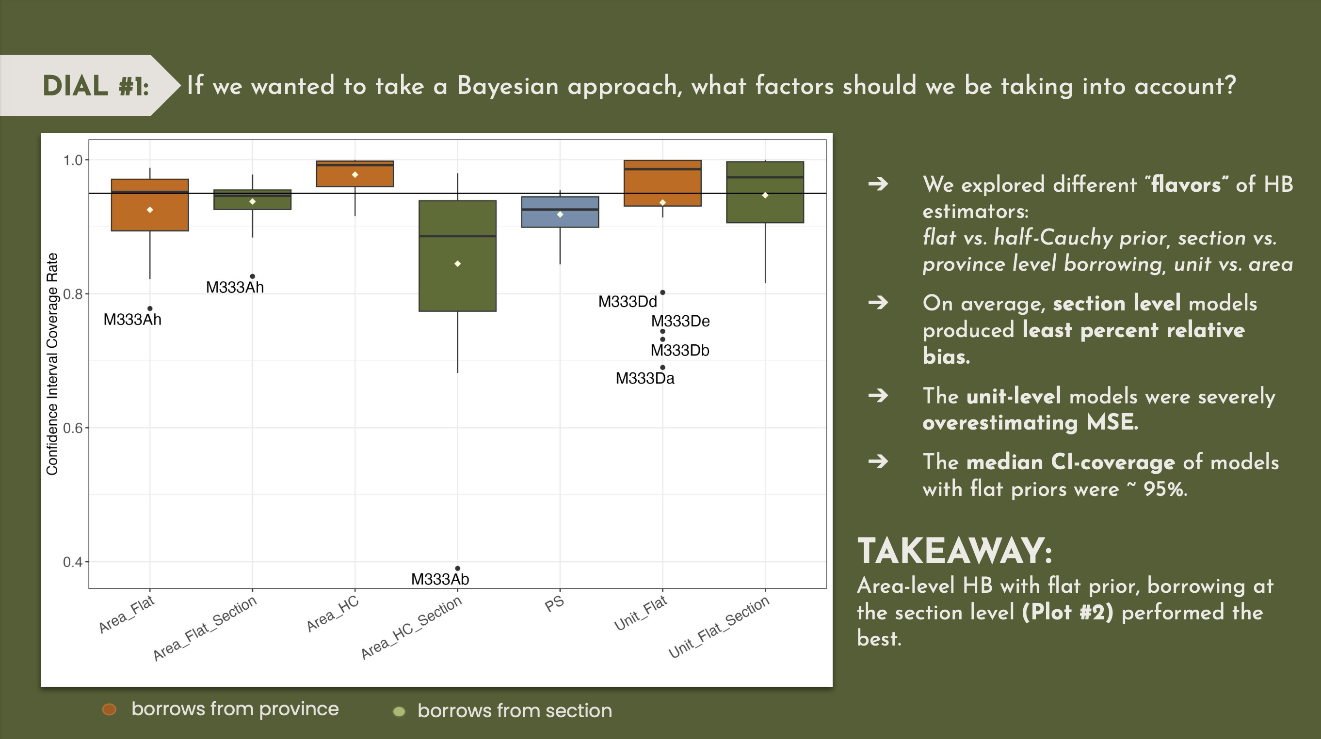

Slide 9
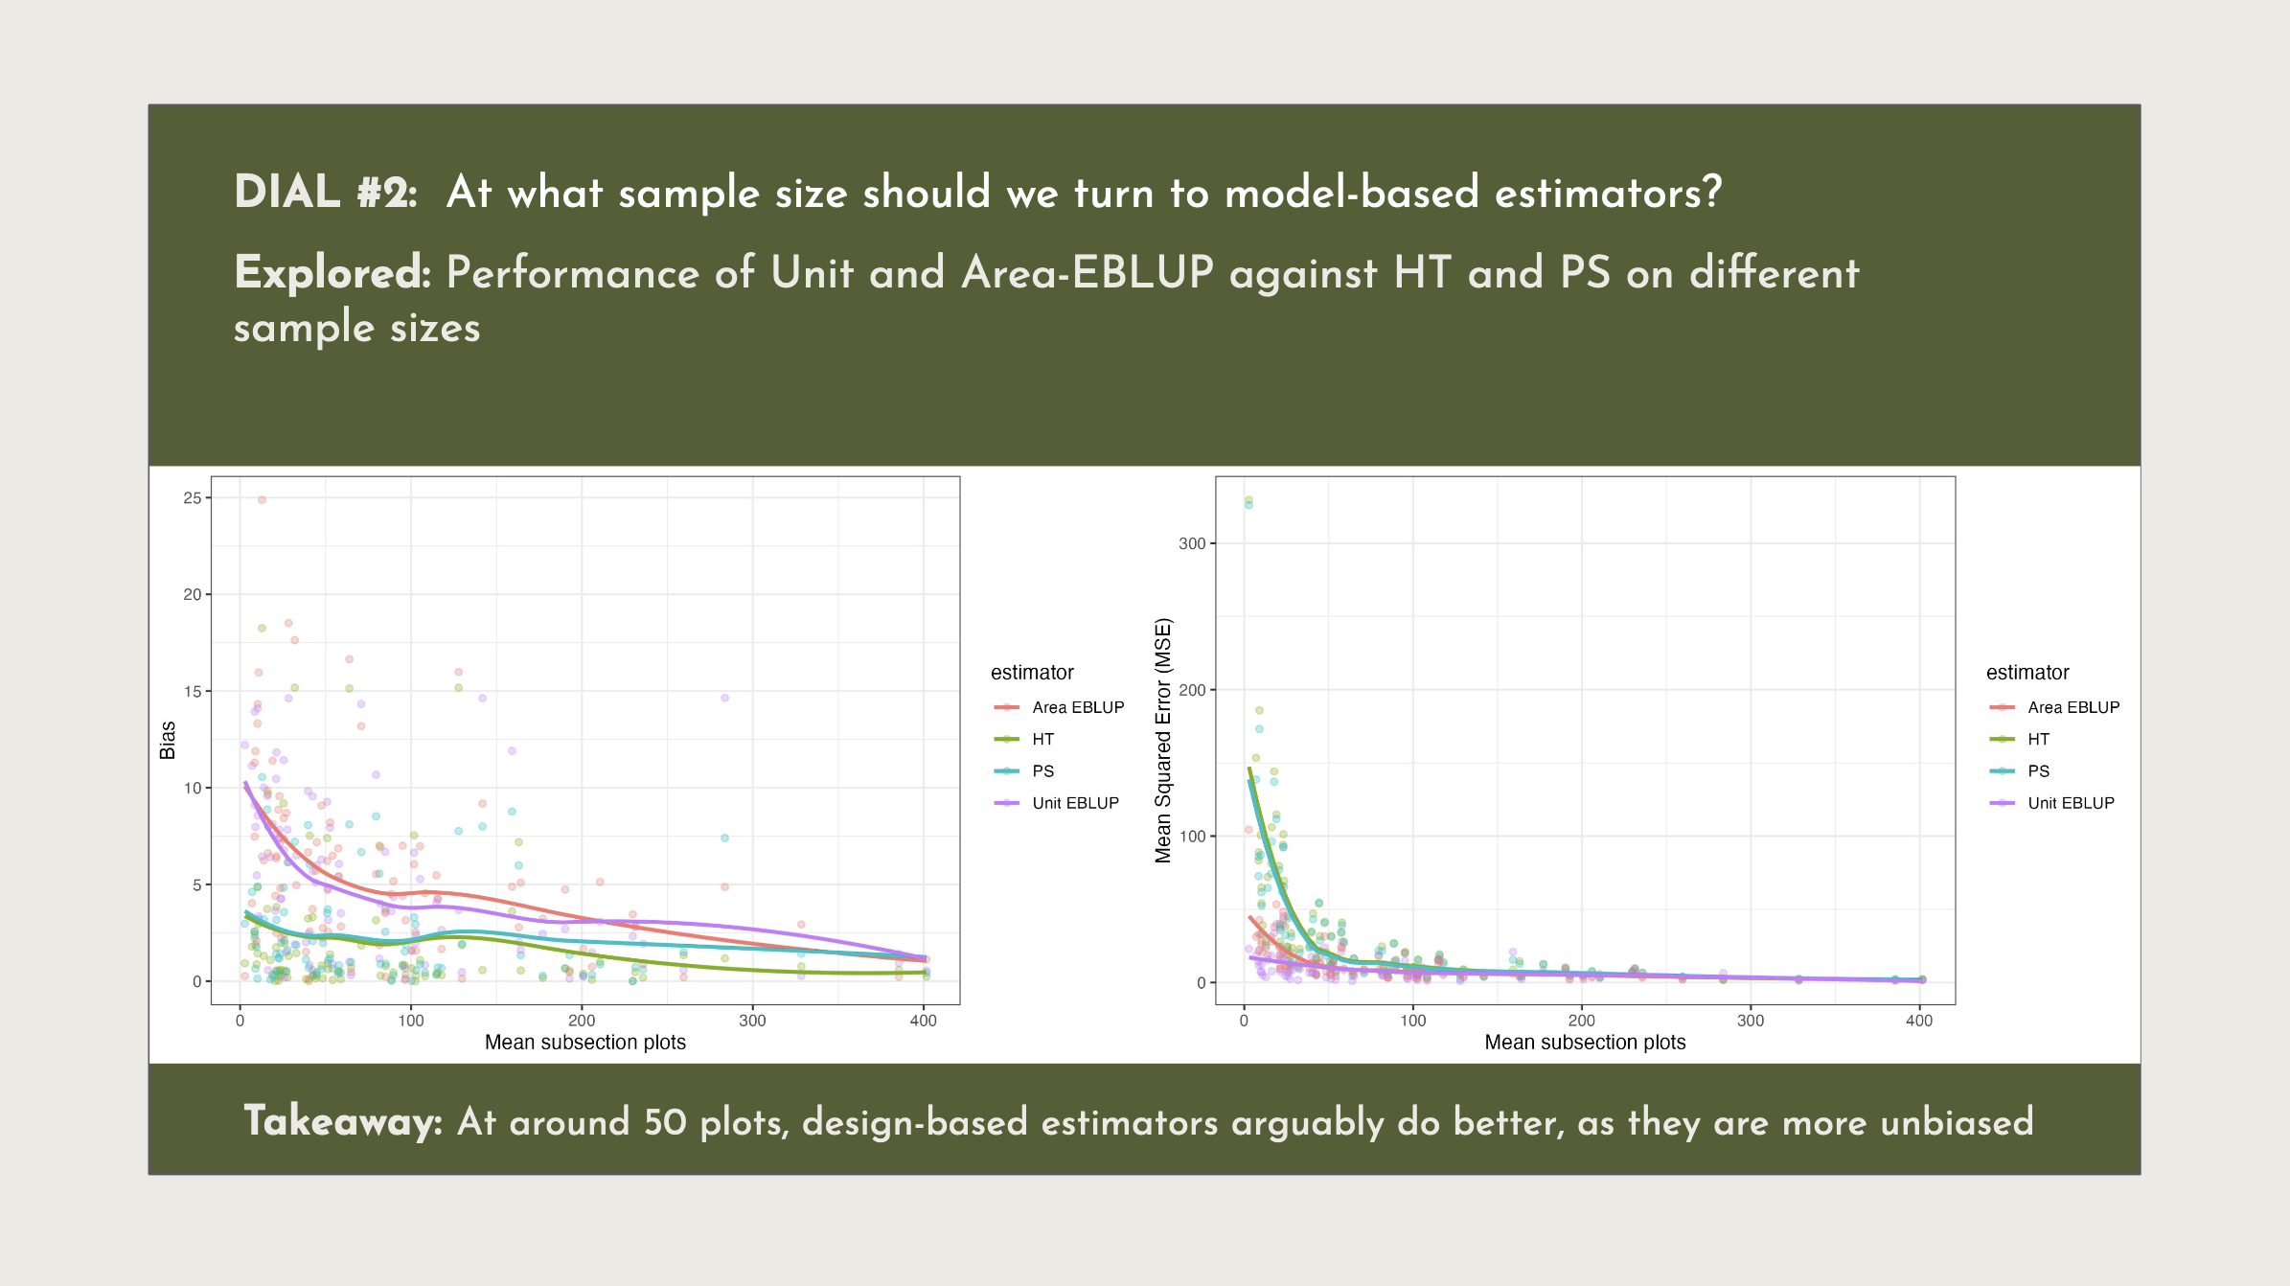

Slide 10
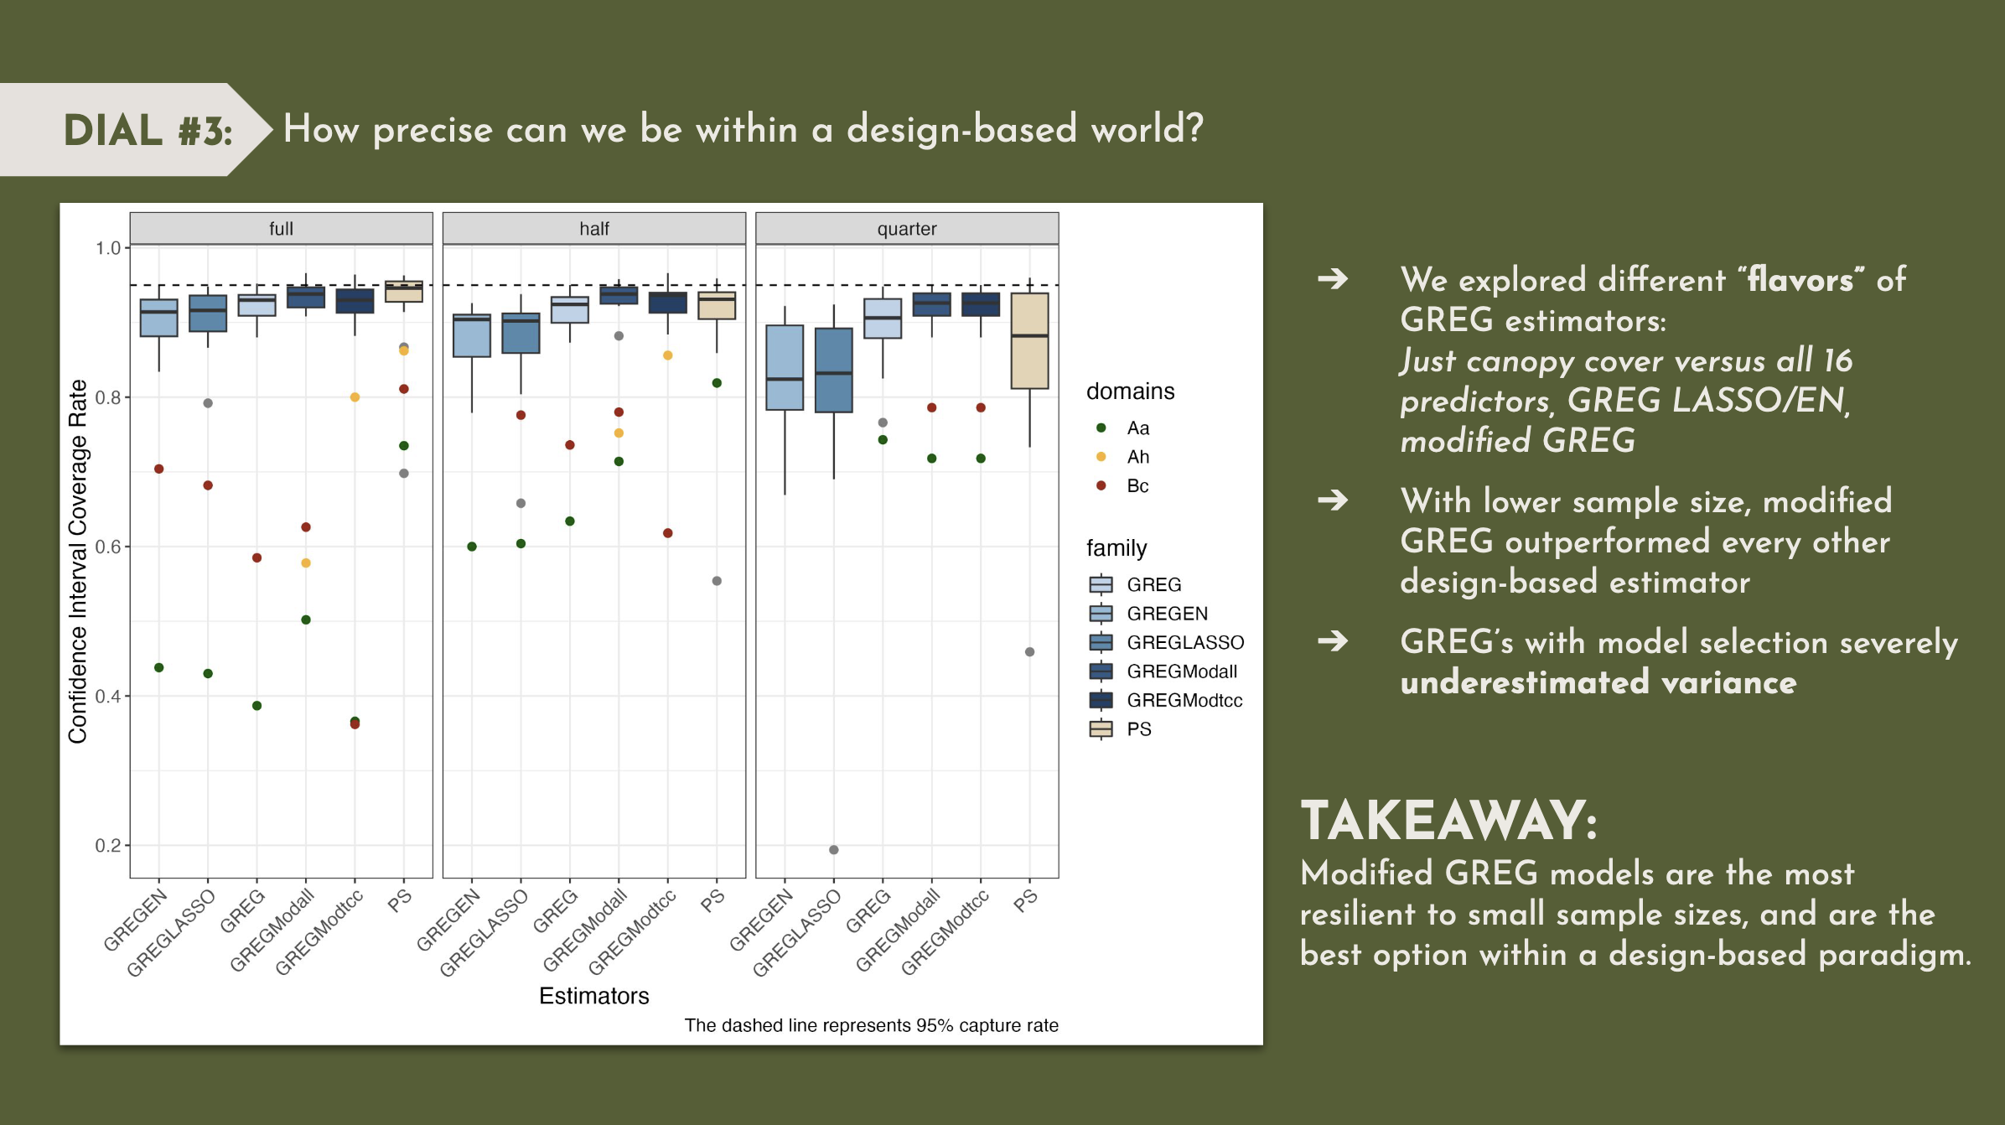

Slide 11
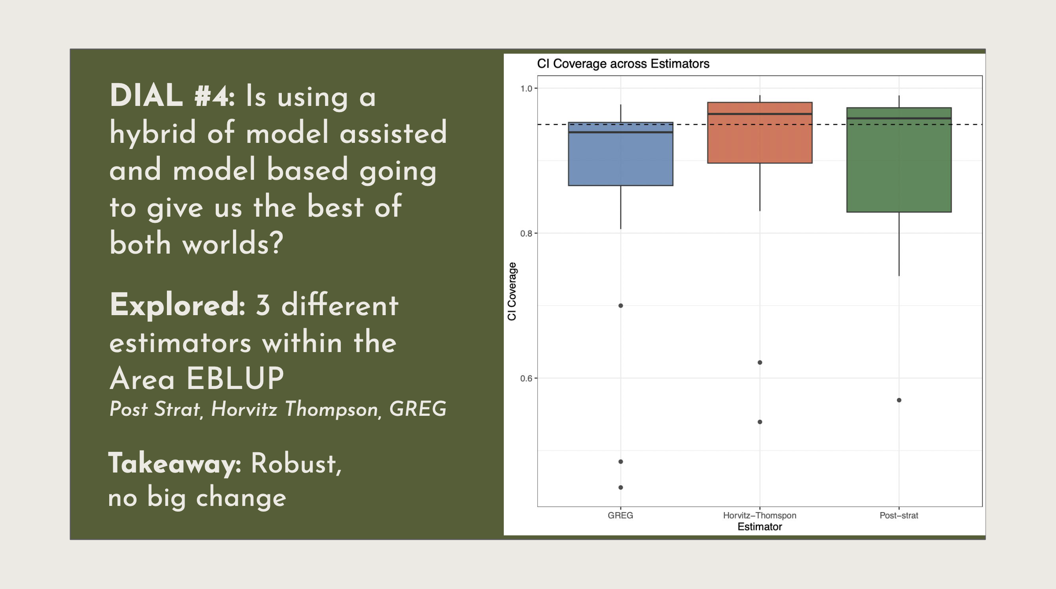

Slide 12
Project: Zero Inflated Estimator
Josh and Julian started the project in Summer 2022.
Dinan and Niels continued it in Summer 2023.
Implemented a two-stage estimator and MSE estimator for zero-inflated continuous data, wrote an R package, and a manuscript!
Josh presented the results here at JSM just yesterday.

Slide 13
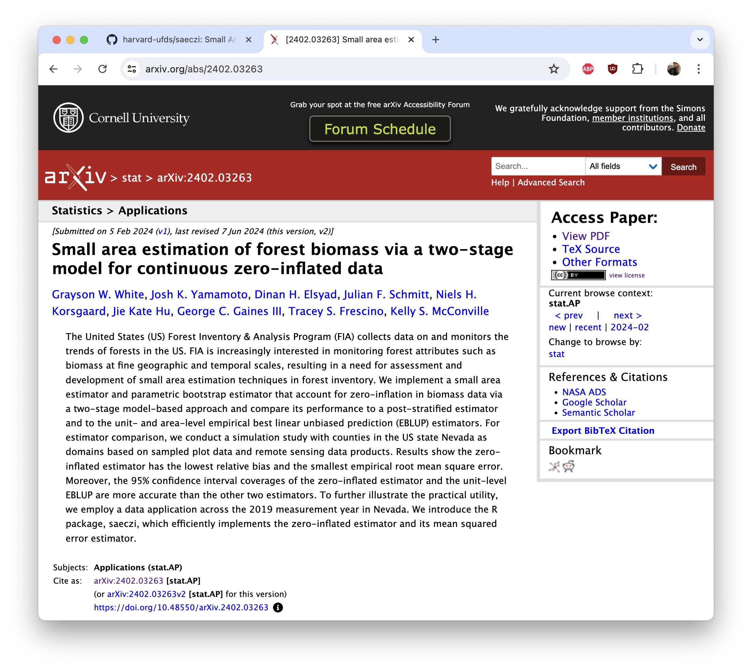
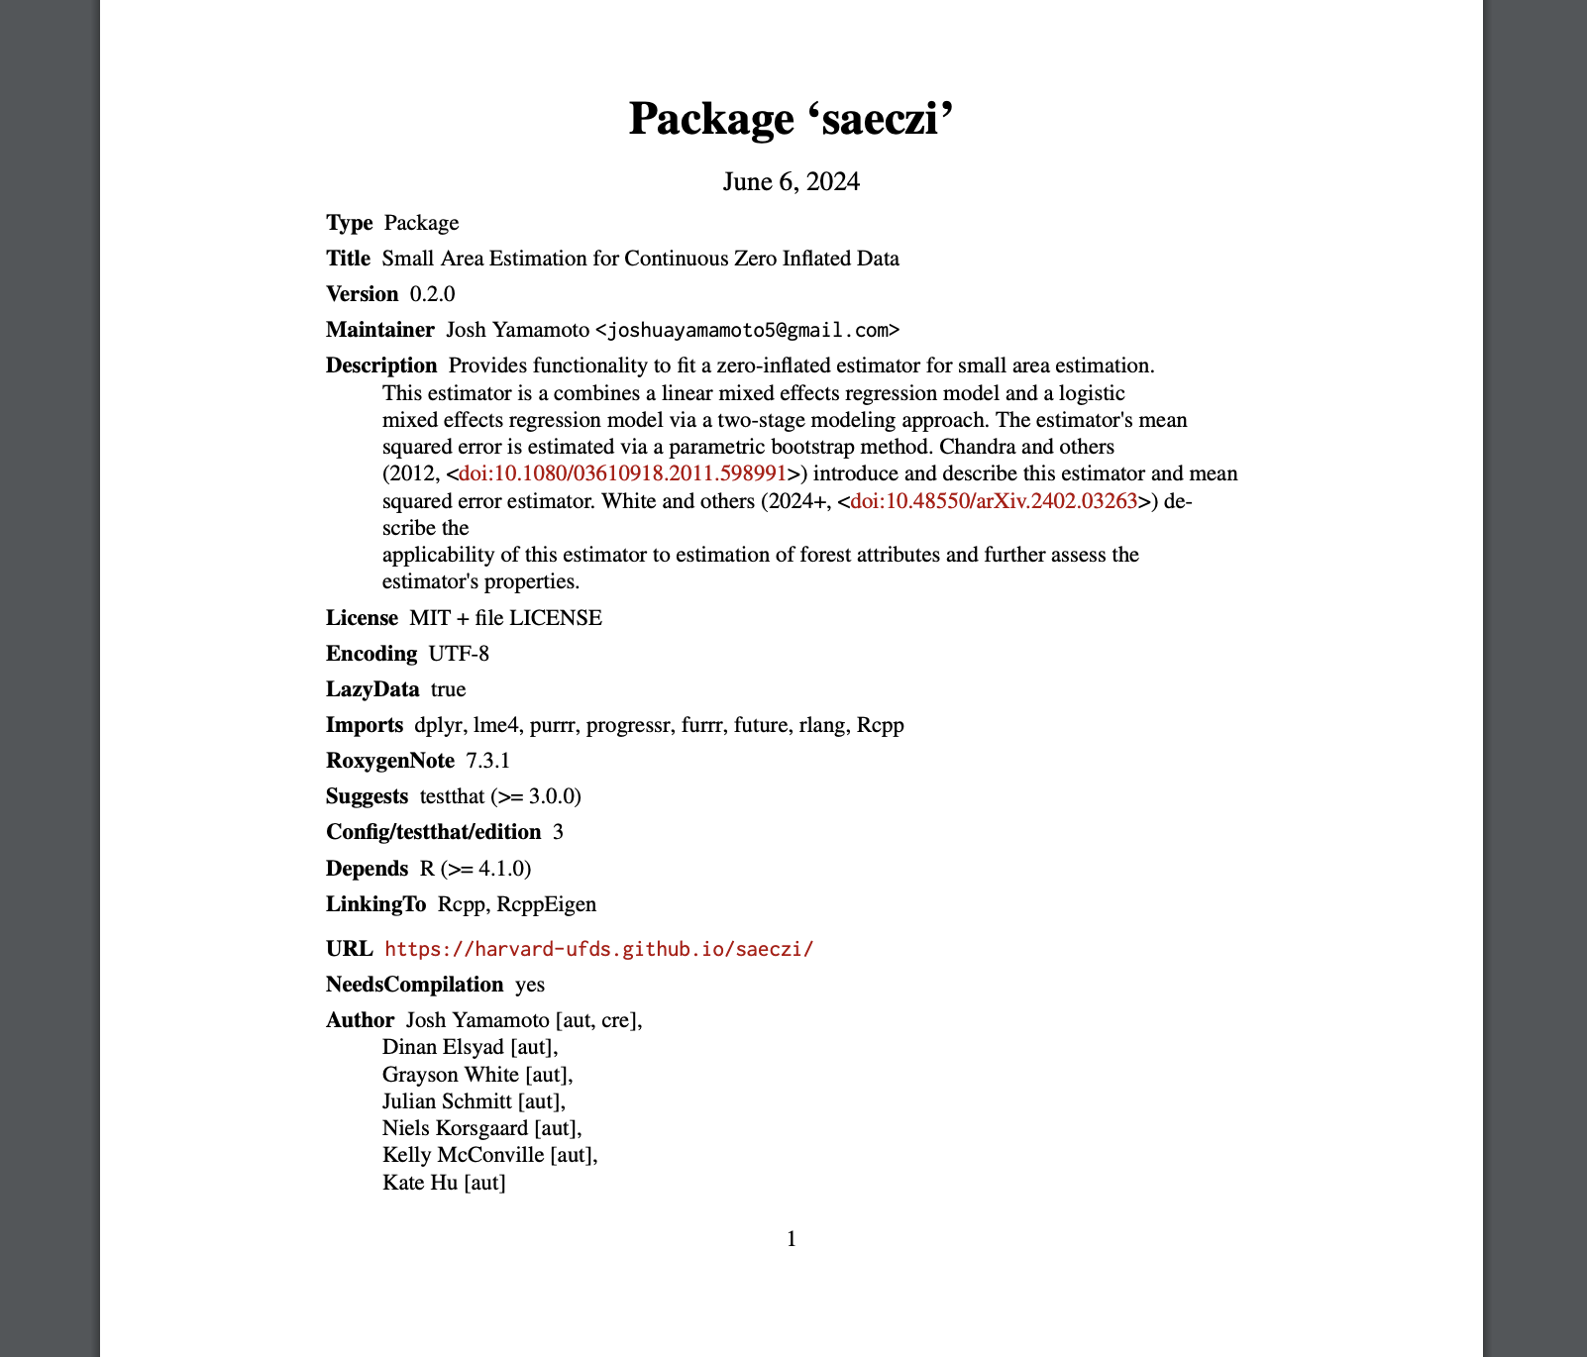
Project: Zero Inflated Estimator
https://CRAN.R-project.org/package=saeczi
https://arxiv.org/abs/2402.03263

Slide 14
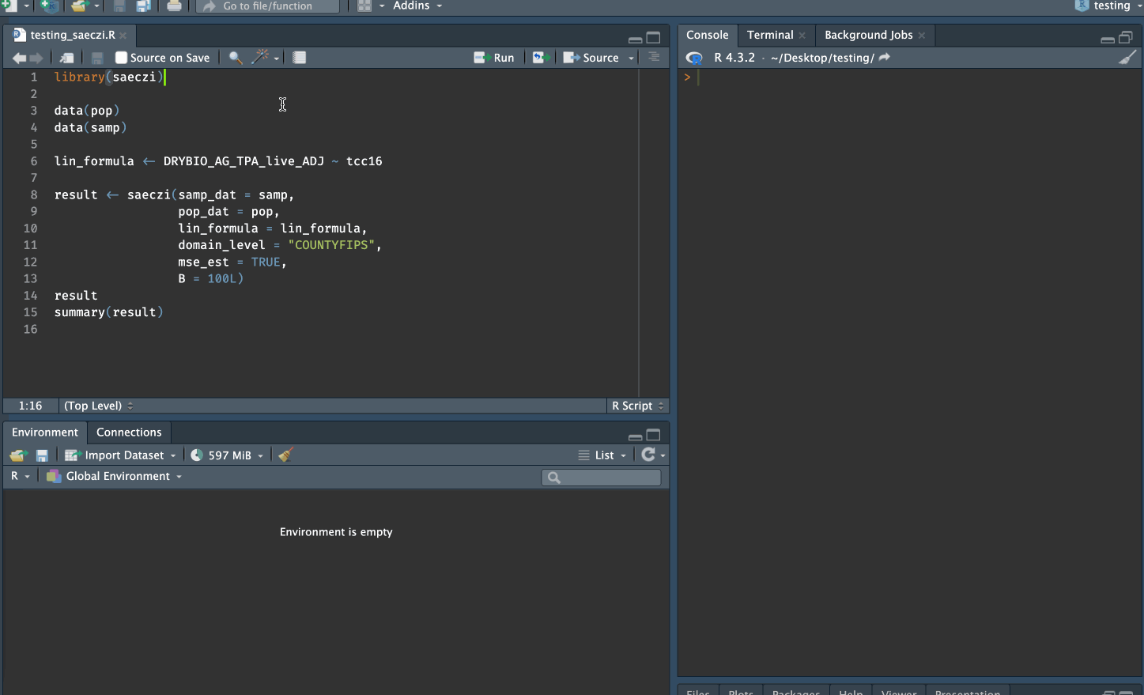

Slide 15
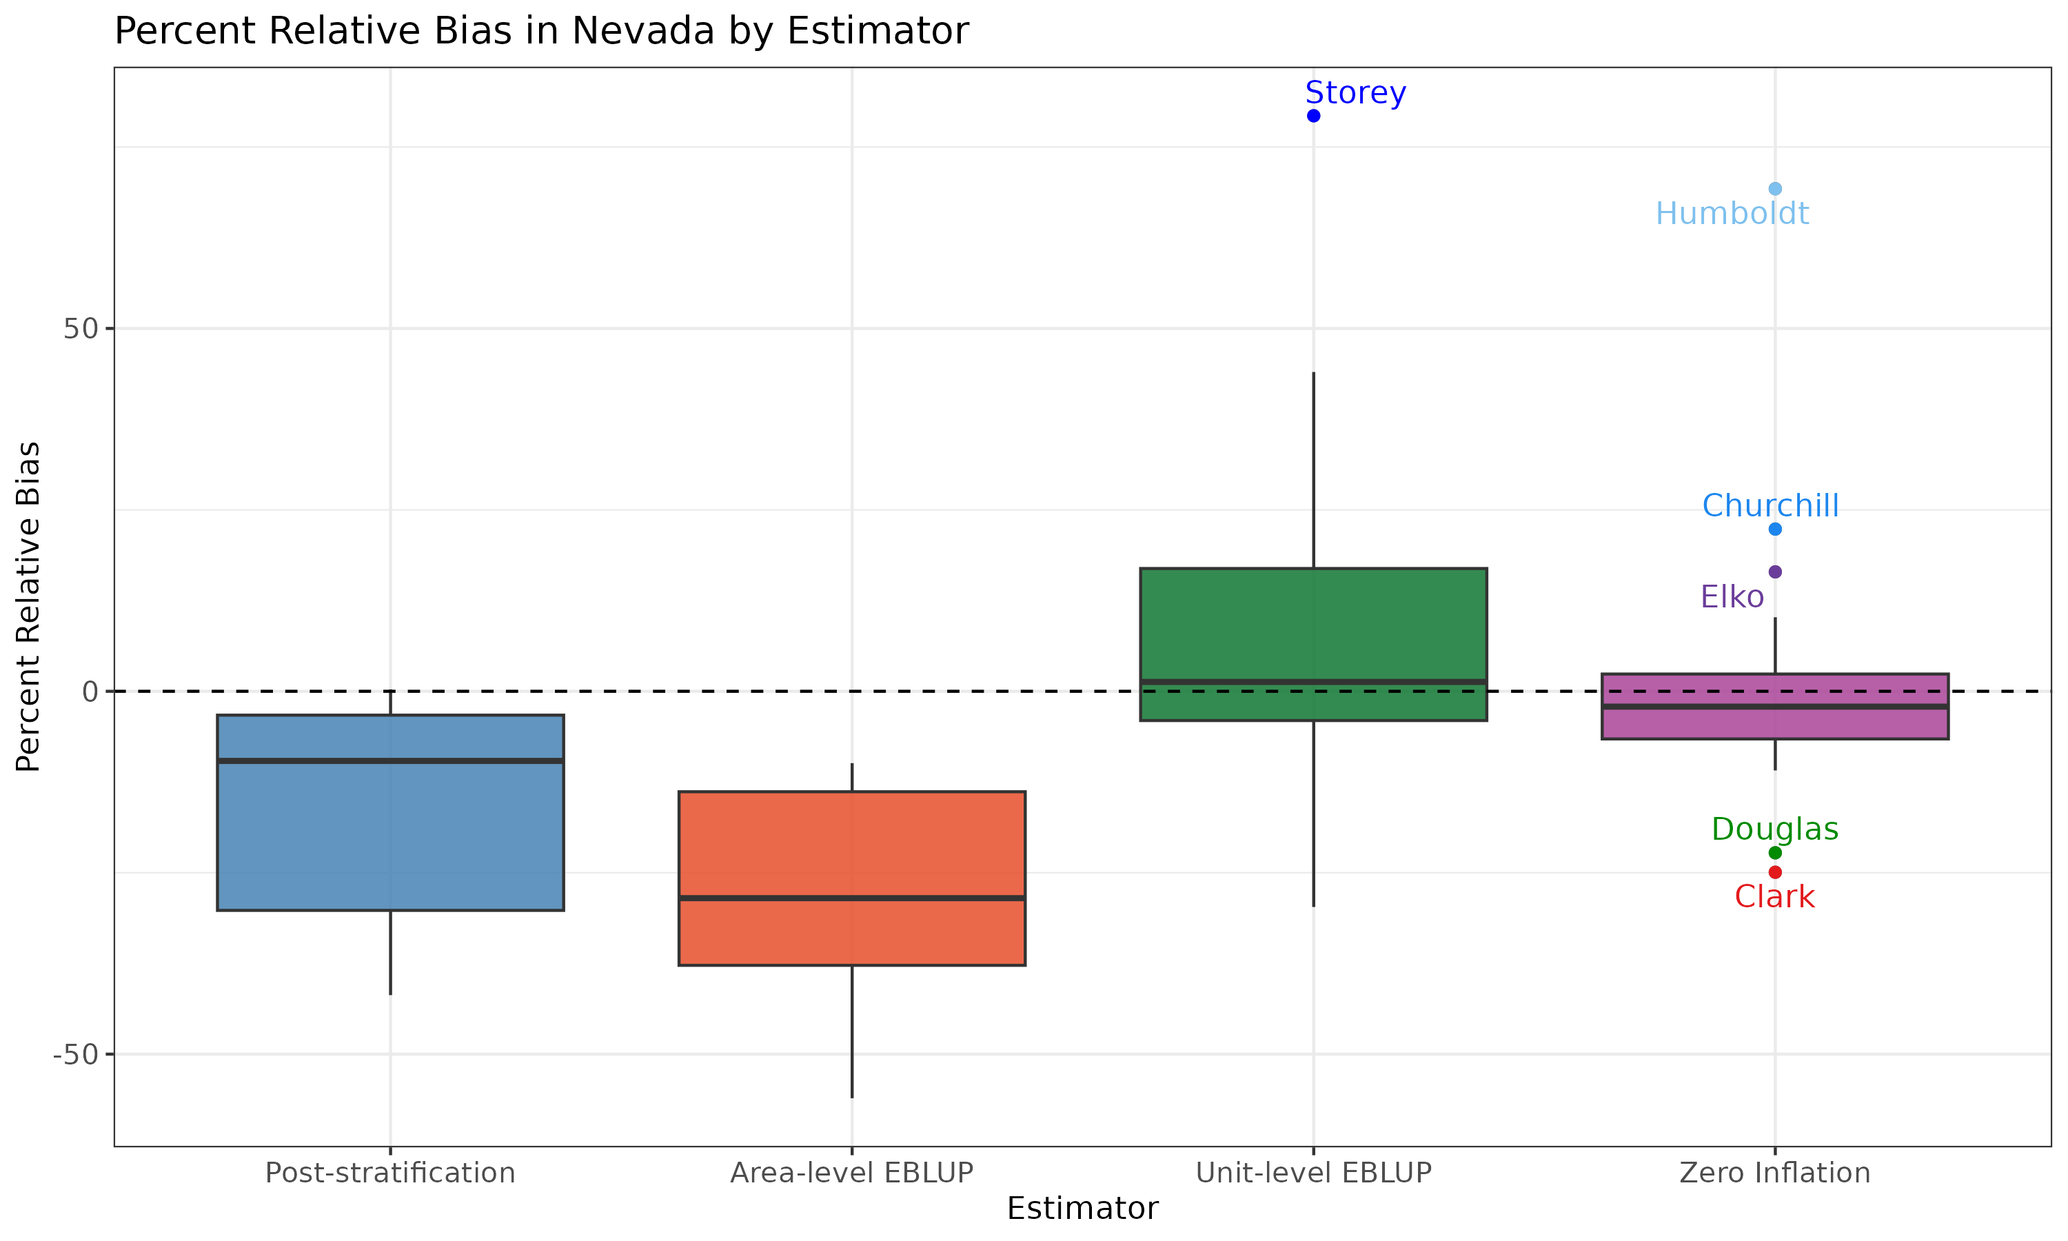

Slide 16
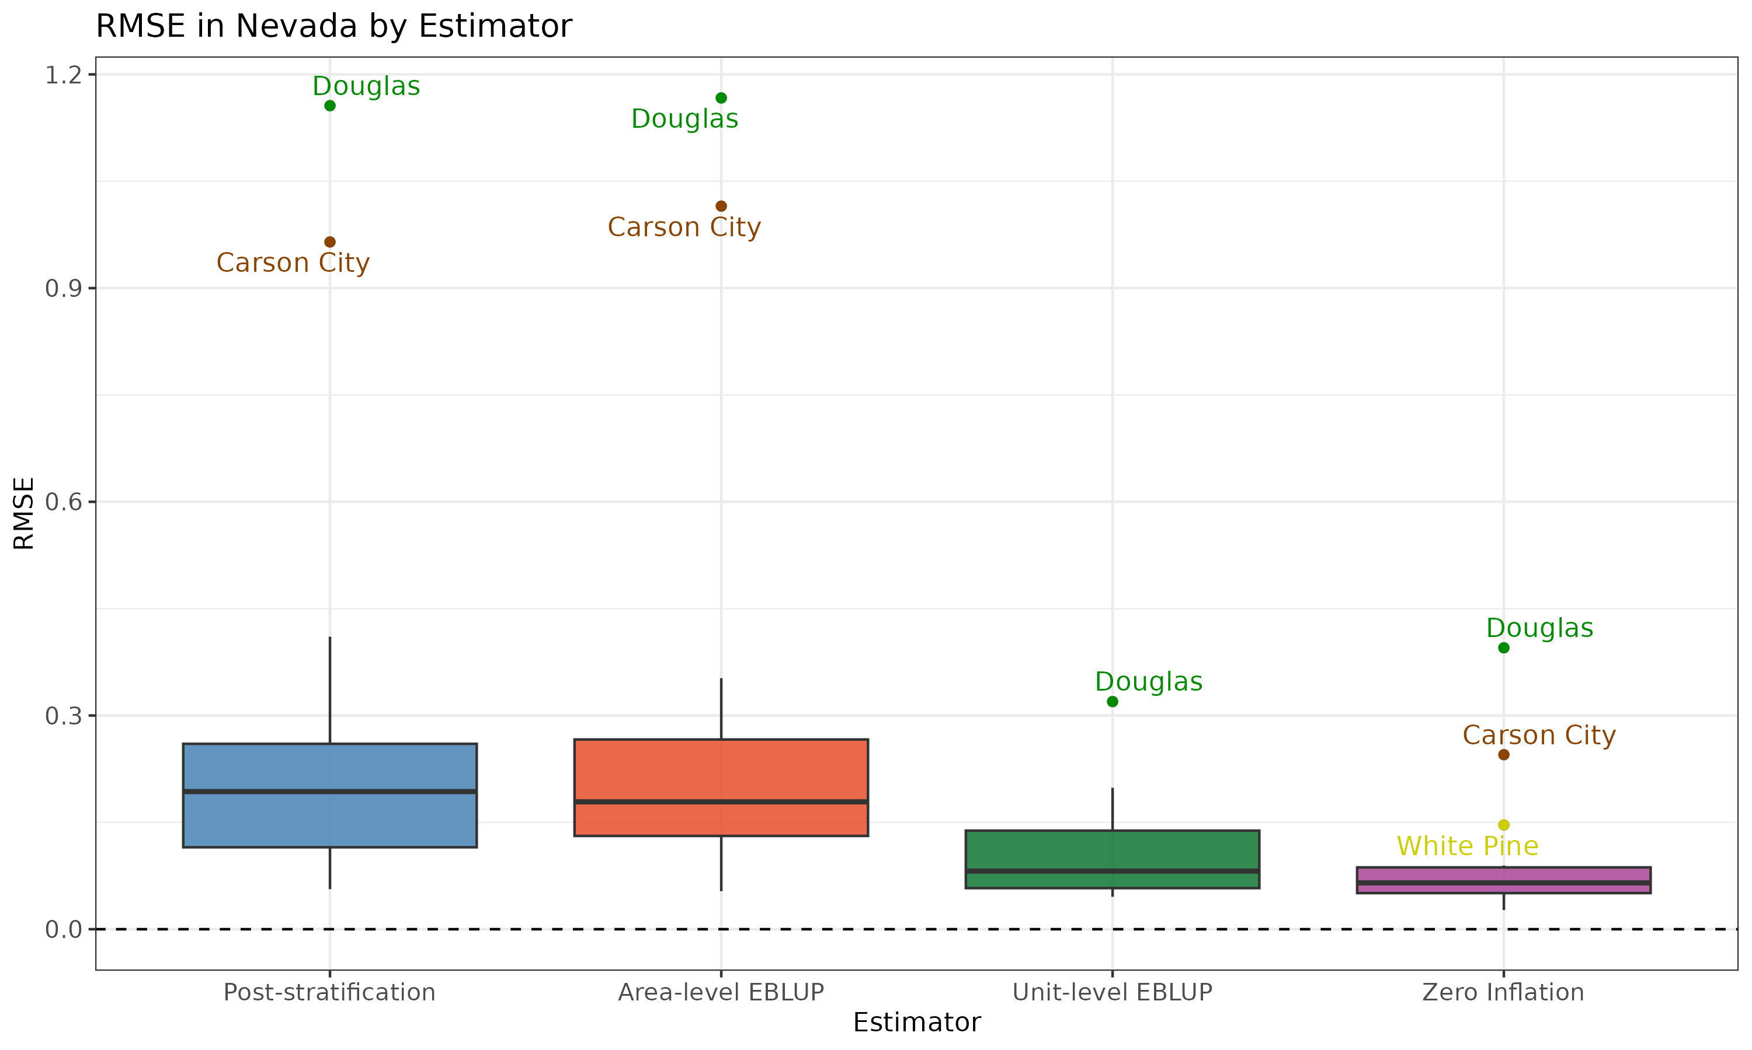

Slide 17
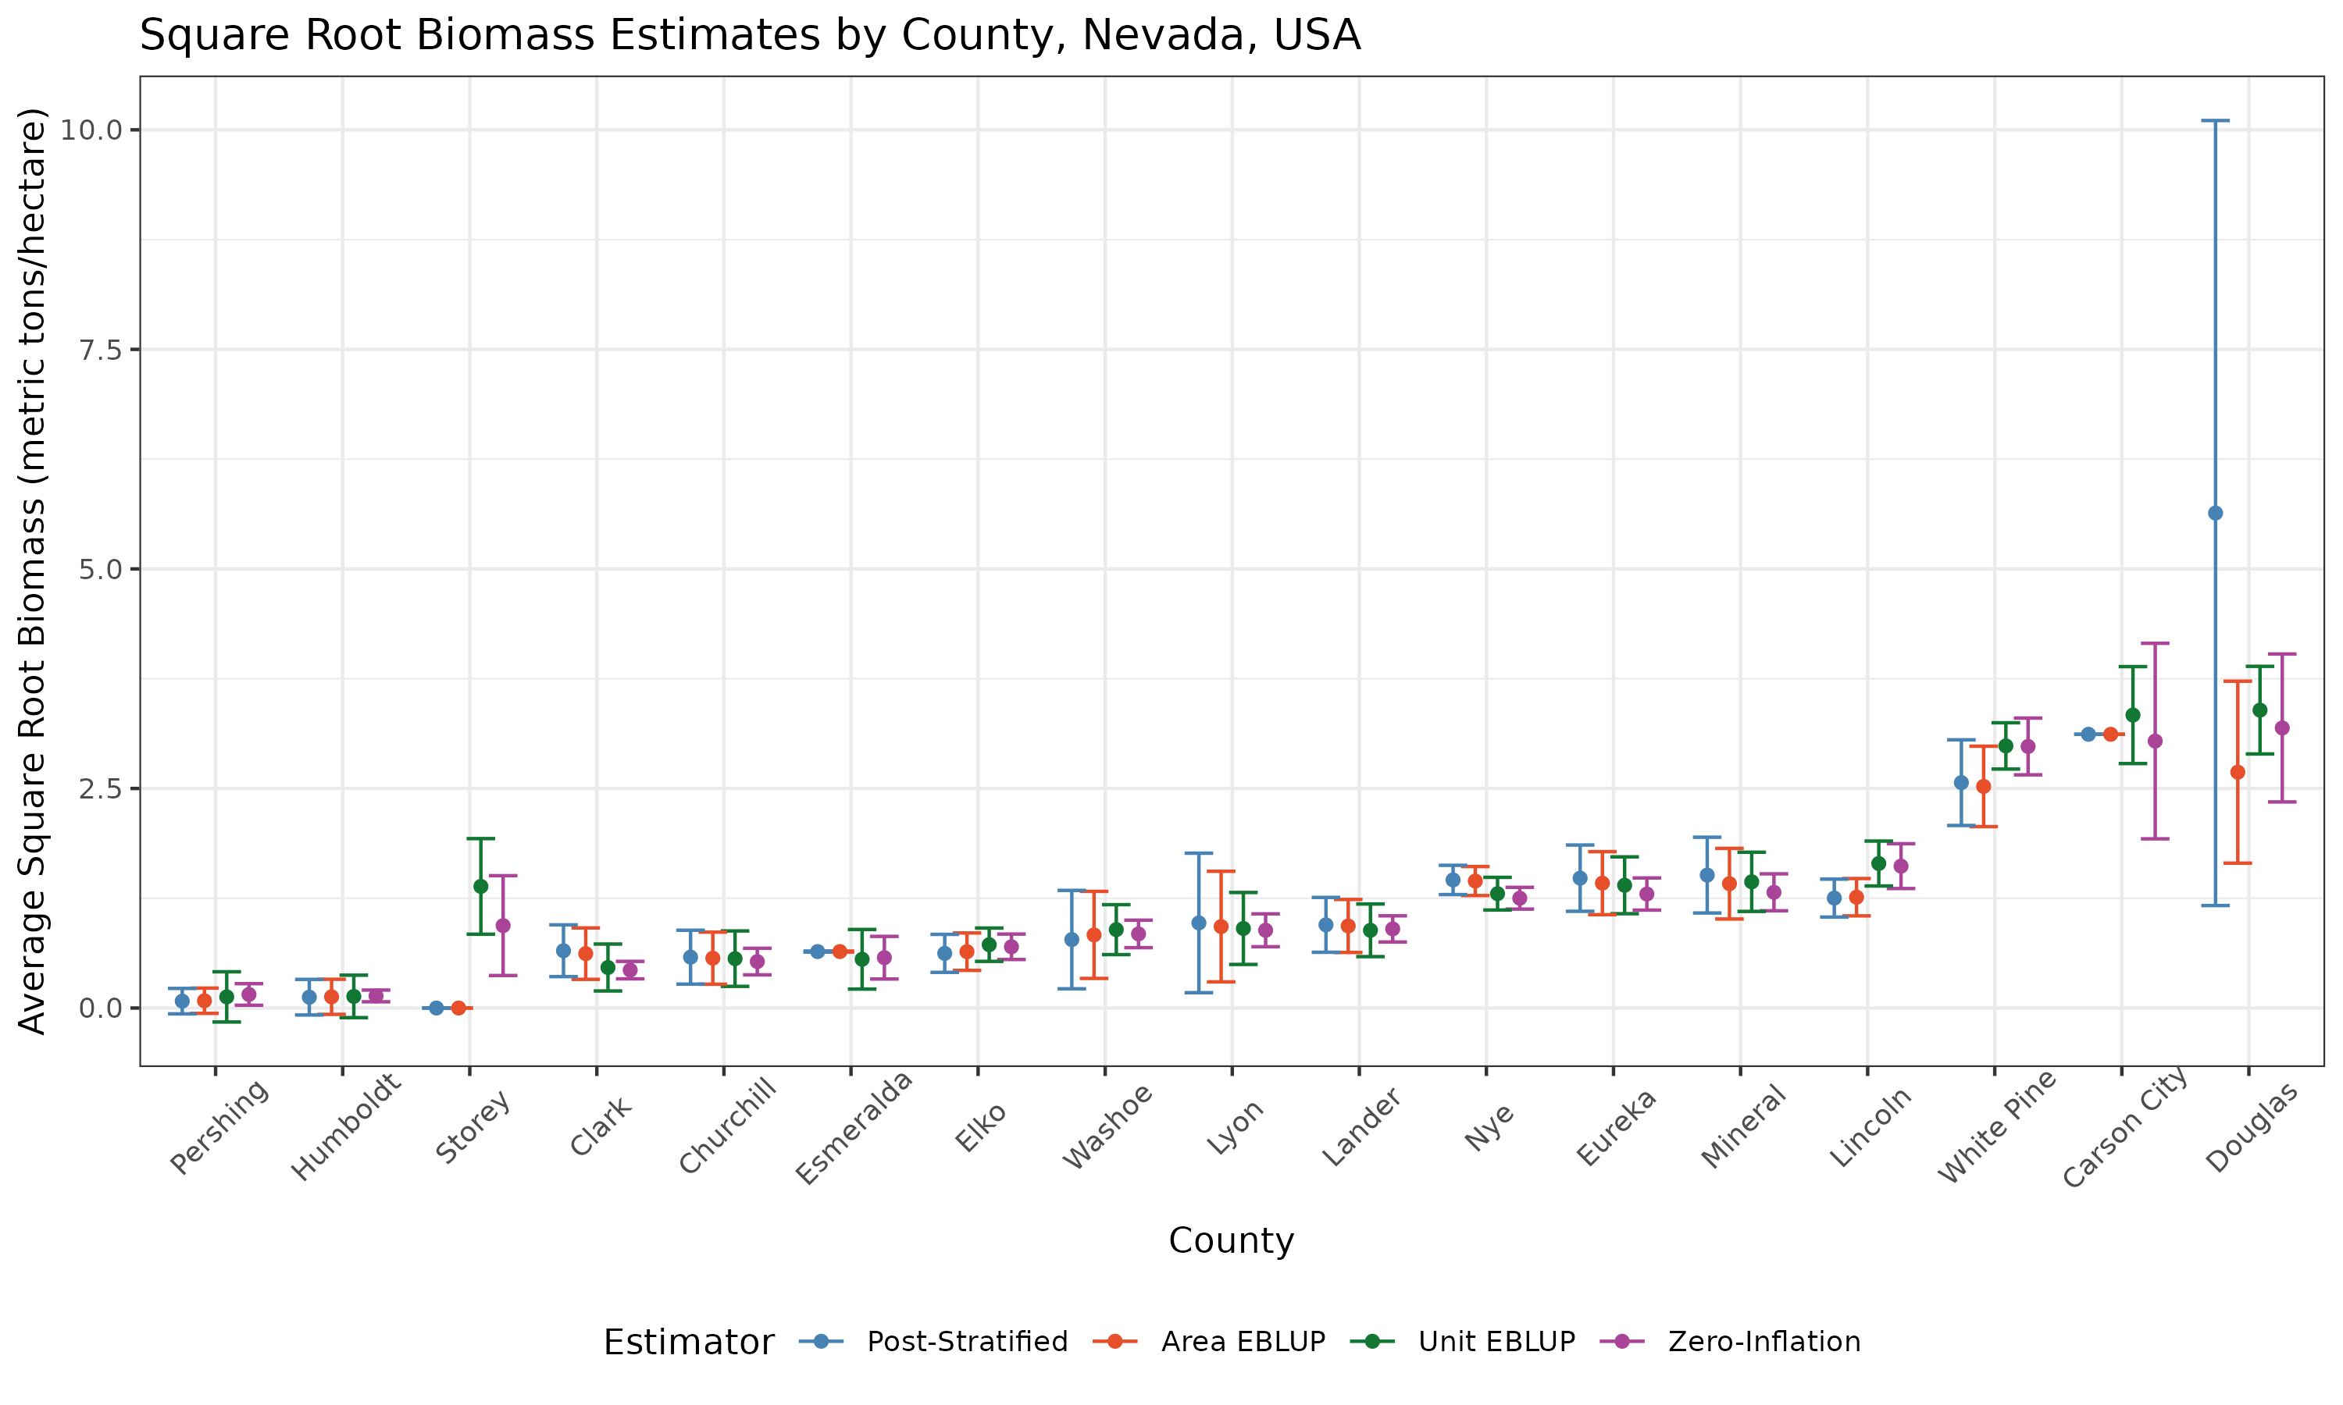

Slide 18
Thank you!

